Slide 1
Quick Guide – LCWIP Walking & Cycling Consultation
Have Your Say !
Feb 23rd to March 23rd 2026

Slide 2




LCWIP = Local Cycling & Walking Infrastructure Plan
Active Travel - All types of pedestrian, walking, running, wheeling, cycling modes of transport.
NOT in a motorised vehicle – cars, lorries, vans, tractors, motorbikes
Wheeling – includes pushchairs, wheelchairs, mobility scooters, kids scooters etc

Slide 3
Project Main objectives :
UK Gov Policy – Increase active travel by 50% by 2030
Wiltshire Council LPT4 - Active travel ‘natural choice’ all short journeys – aligned with National Policy.
..so that, ‘50% of shorter journeys ‘active’ mode by 2030’
Less Car trips within town & local district - in proportion to above increase
Health, well-being, obesity – all improved.
Make Malmesbury Even Better - attract more visitors / tourists.
AND:-
County gains higher rating; 16 LCWIPS = access more funding

Slide 4
Why Do we NEED an LCWIP? :
To deliver Government & Council Policy
To encourage people to choose Active Travel
To reduce short journeys made by motor cars
To make people fitter, healthier & happier
Because there are 400 – 500 more new-build houses planned
Car ownership per house is increasing - 2 or 3+ per home
To free-up urban space used for car parking
To reduce traffic level and speeds in the town
To Make Malmesbury Even Better !

Slide 5
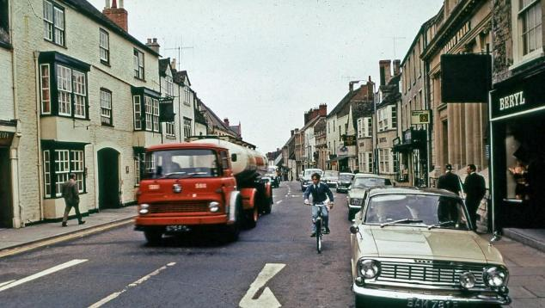
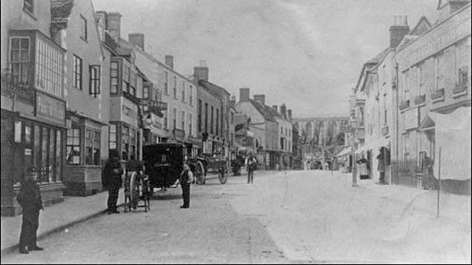
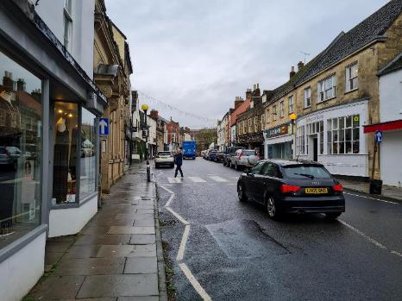
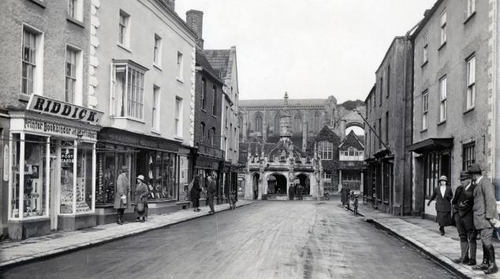
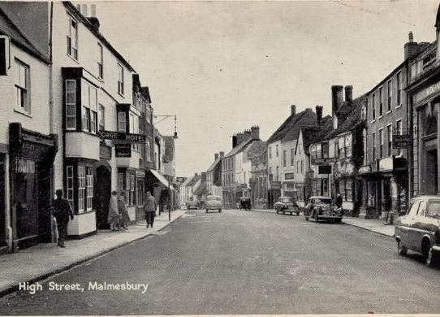
1890’s
1975
1950’s
2025
1924

Slide 6
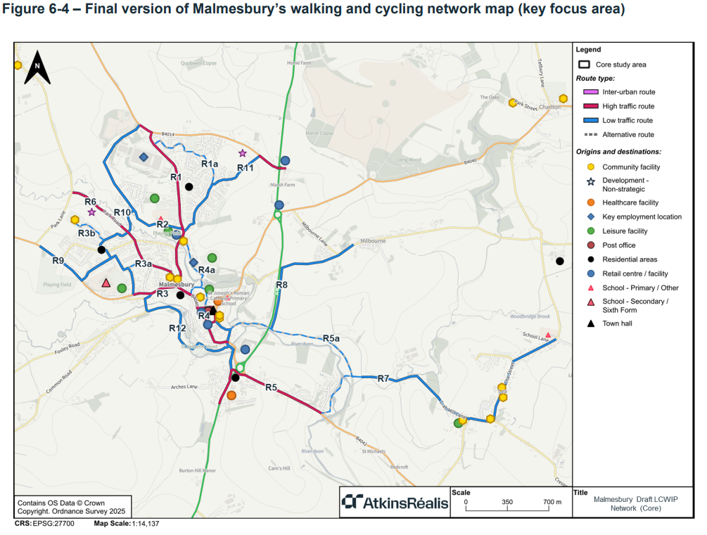
Draft Route Plan
Malmesbury
From
LCWIP Report
Ref – Malmesbury LCWIP report . pdf
17 Routes in Total
12 + Xa = 17

Slide 7
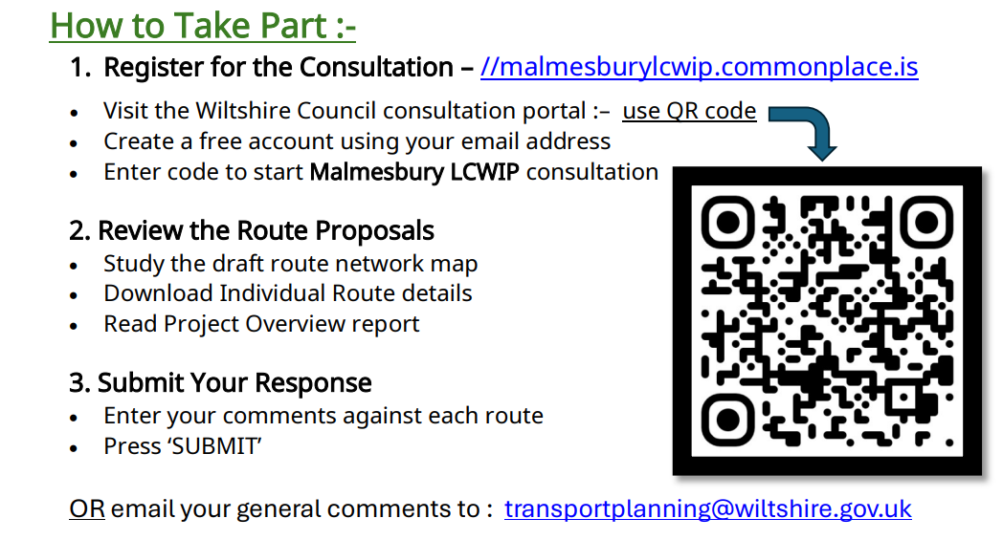

Slide 8
How the Web Portal looks to users
https://malmesburylcwip.commonplace.is/

Slide 9
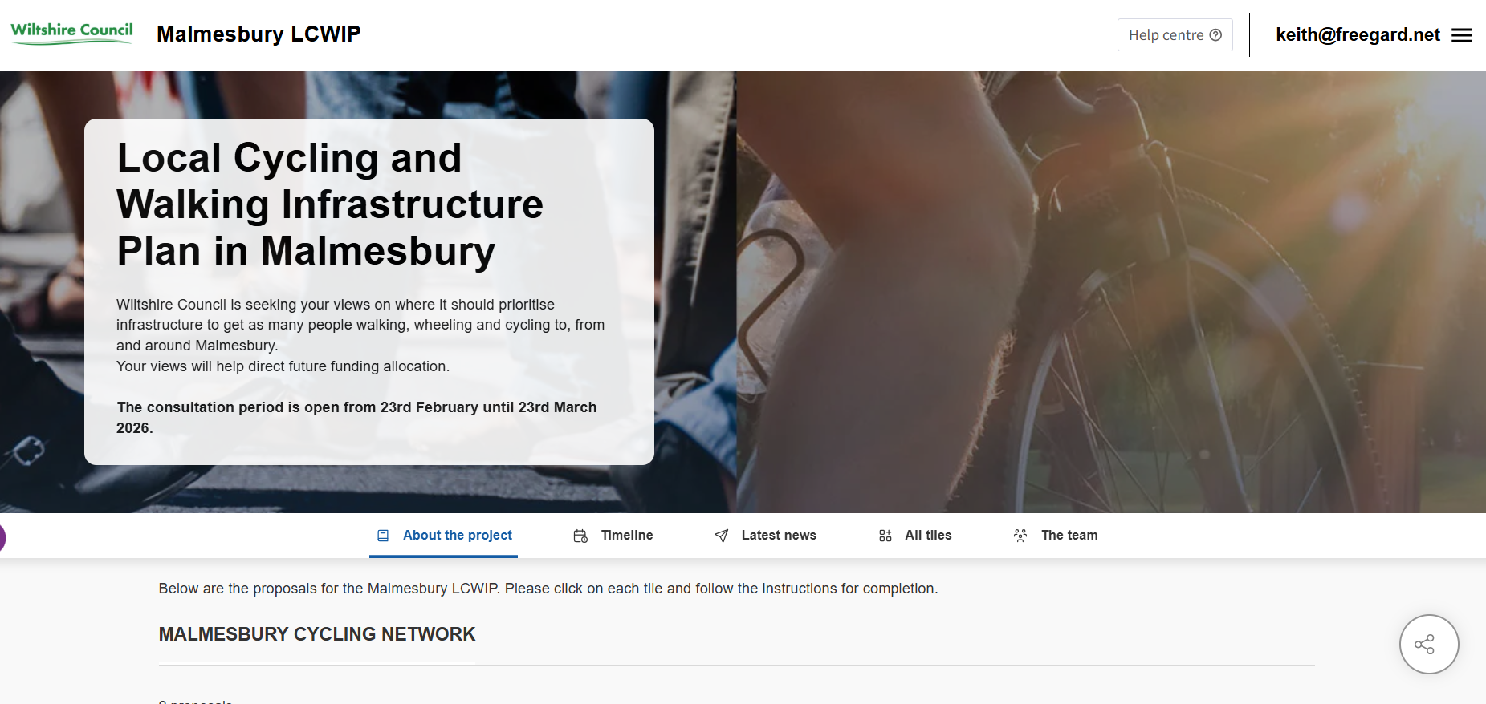

Slide 10
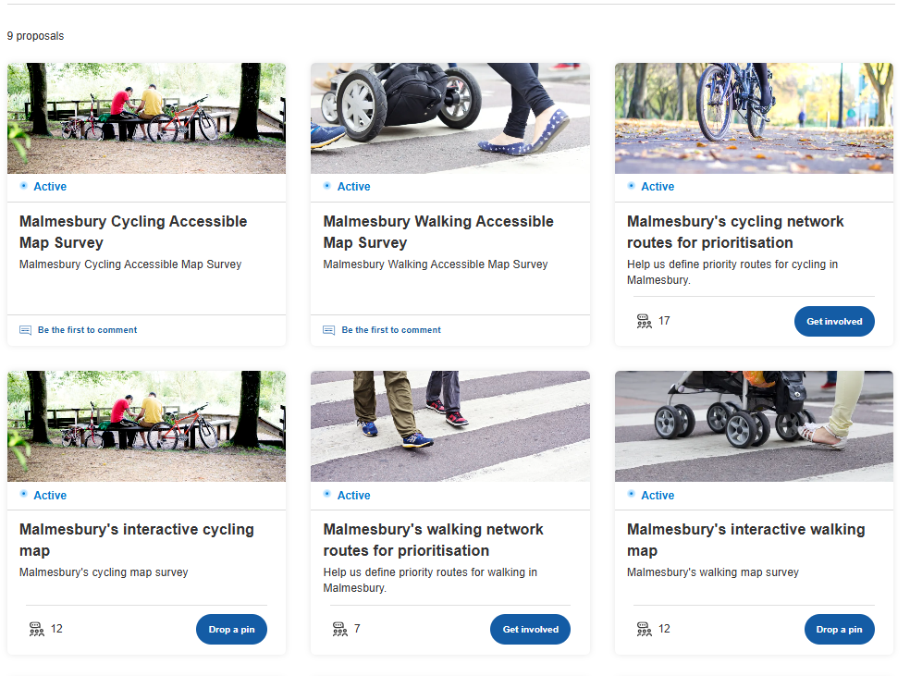
Choice Tiles – for User to select what they want to comment upon

Slide 11
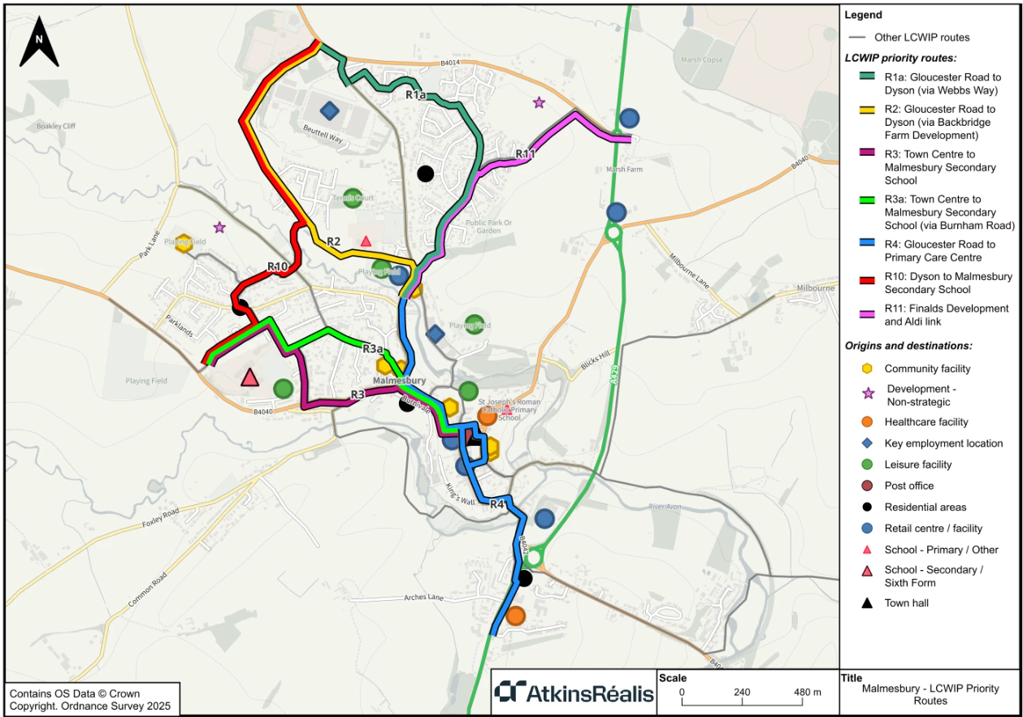
Priority Route Map
For Users to List in Order of Importance

Slide 12
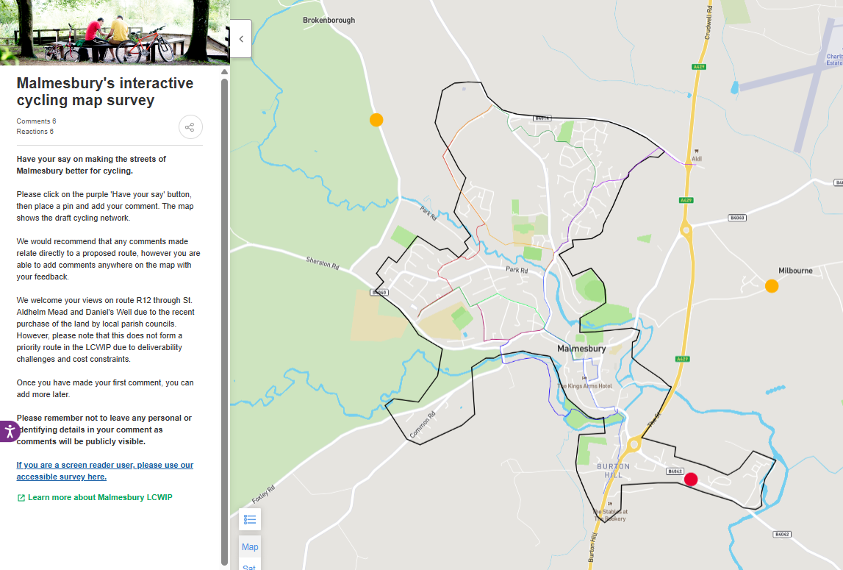

Slide 13
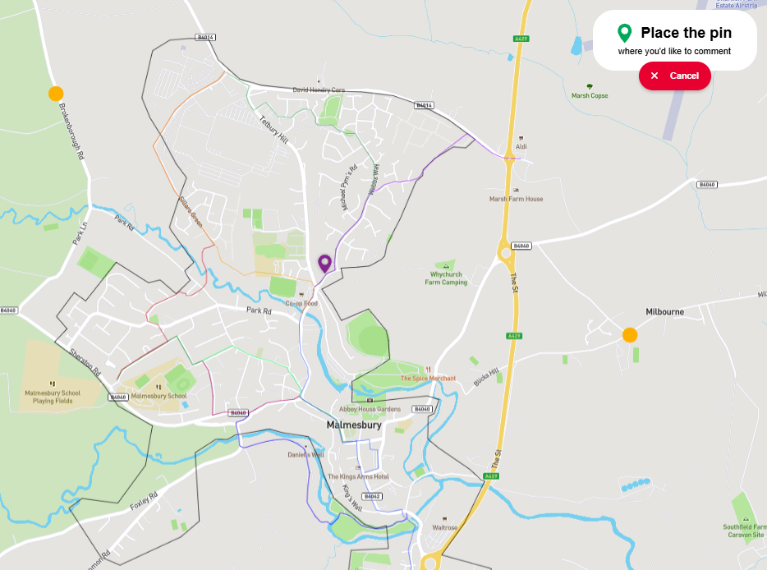
Drop a PIN to make a comment

Slide 14
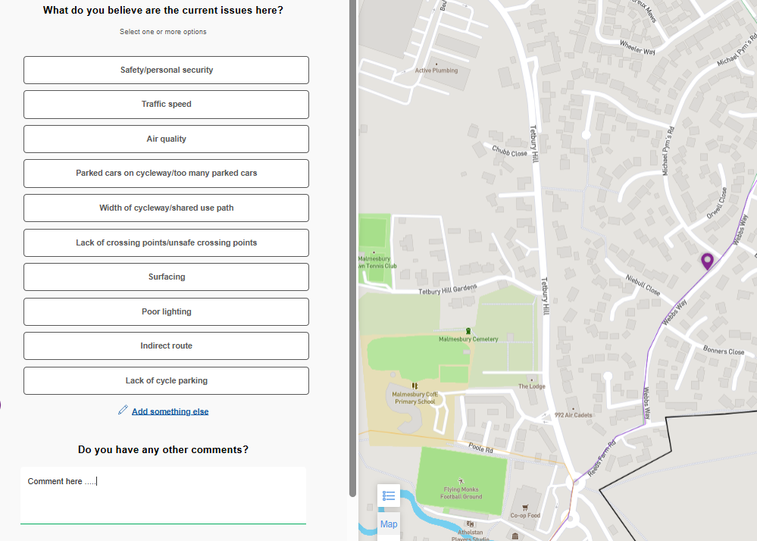
Answer list of questions and make your comment

Slide 15
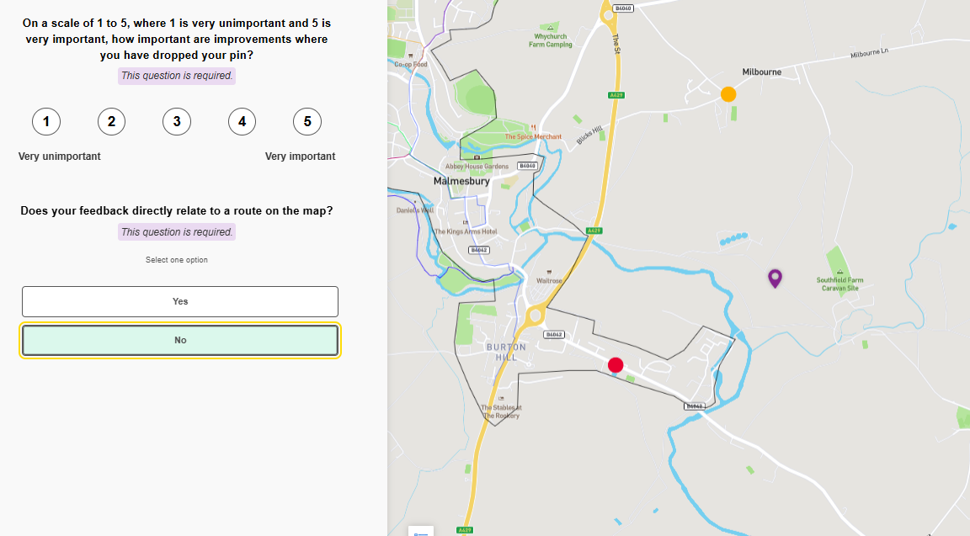
Your comment DOES NOT have to be about a particular marked route

Slide 16
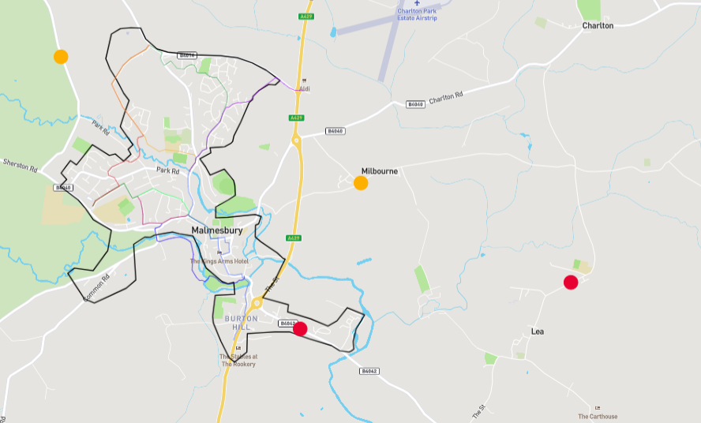
Your comments get recorded as a DOT on map – But ARE Anonymous

Slide 17
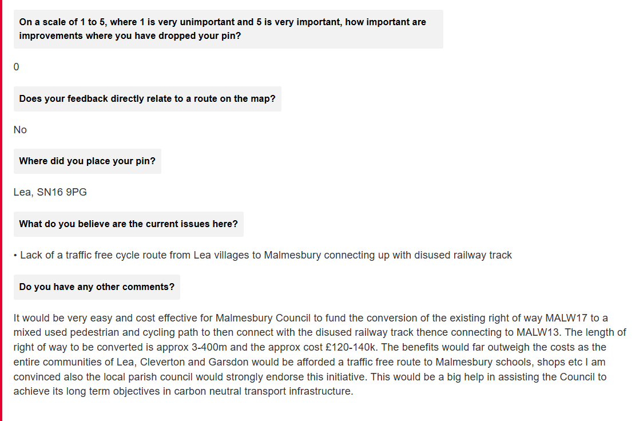
Typical response
format

Slide 18
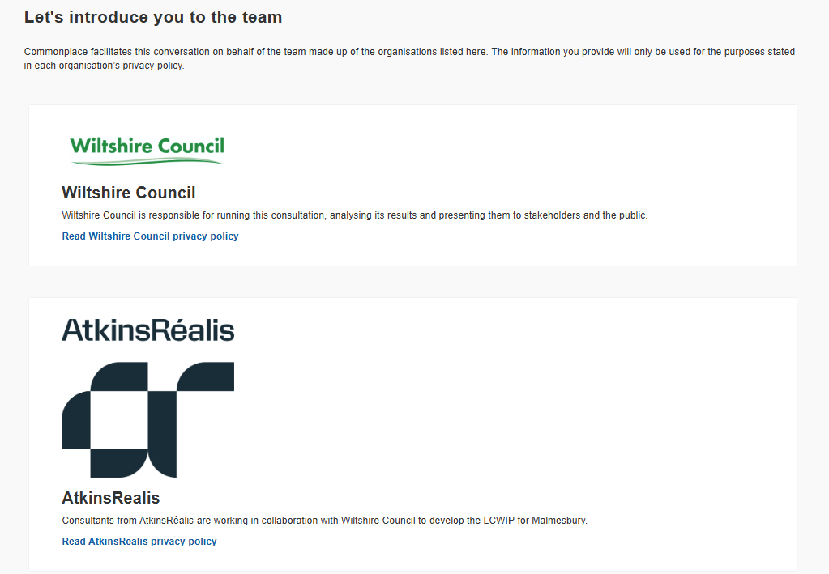

Send Comments by Email – AS WELL !
Simpler than the web portal :-
Wilts Council & Consultant Team
Managing The Project

Slide 19
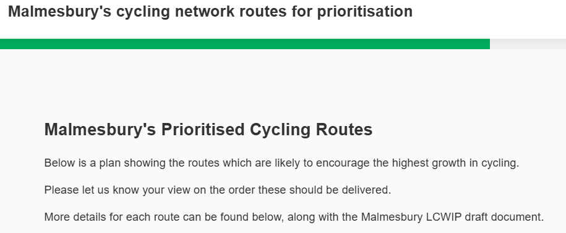
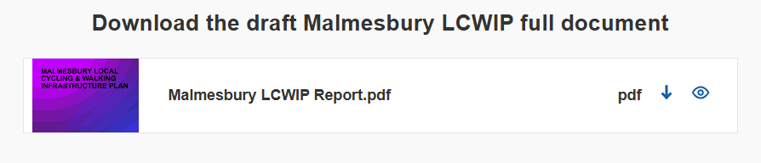
Want to Read the Full LCWIP Report ?
Scroll to Bottom of Route Priority Detail Listing Page - download
https://malmesburylcwip.commonplace.is/en-GB/proposals/v3/malmesbury-cycling-prioritisation?step=step1

Slide 20
Any Questions ?
Malmesbury LCWIP Team at :-
transportplanning@wiltshire.gov.uk

